Slide 1
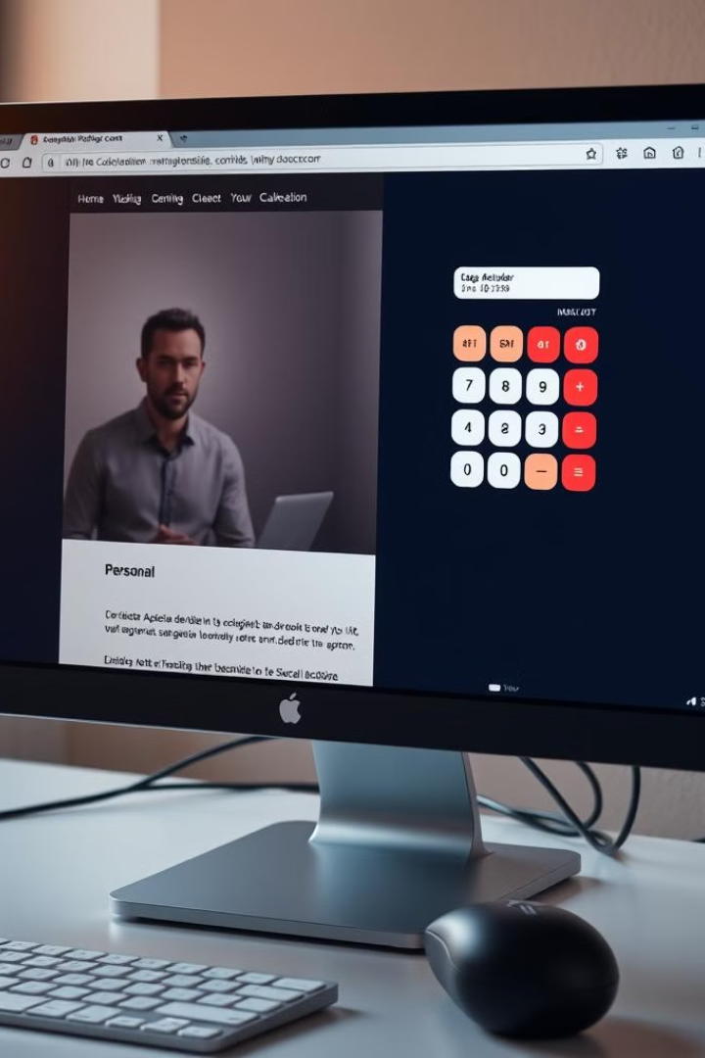

Personal Webpage and Simple Calculator Project
NAME: LOKESH KUMAR MISHRA
B.TECH, COMPUTER SCIENCE
ROLLNO: 2300290120133
by Lokesh Mishra

Slide 2
Project Overview
Personal Webpage
Simple Calculator
Easy-level project using HTML.
Medium-level project using HTML, CSS and JavaScript.

Slide 3





Personal Webpage Features
Profile Photo
Brief Bio
Social Links
Displays student's image.
Introduces Lokesh Kumar Mishra.
Connects to professional profiles.

Slide 4

Simple Calculator Features
1
Basic Arithmetic
Performs addition, subtraction, multiplication, and division.
2
Real-time Display
Shows results instantly as user inputs numbers.
3
User-friendly Interface
Easy-to-use buttons for numbers and operations.

Slide 5

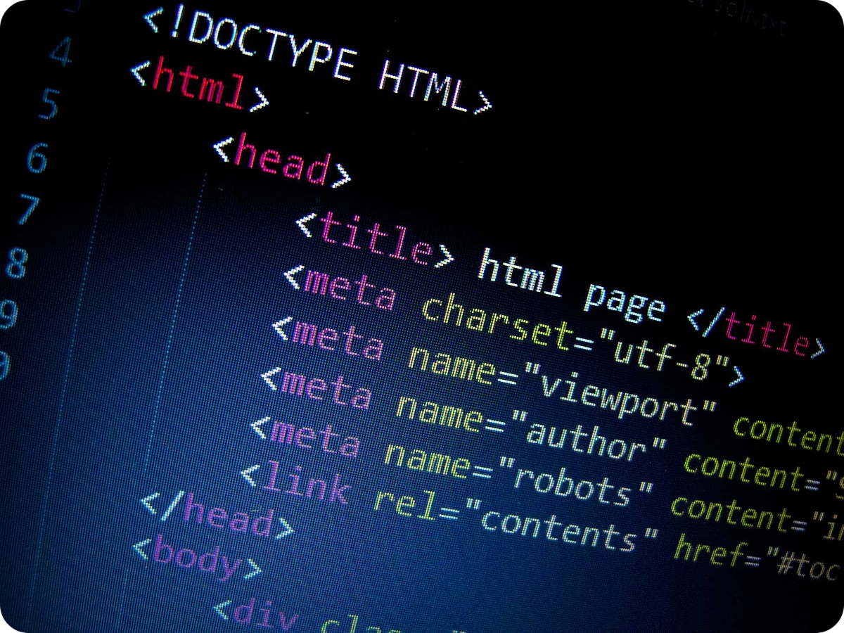
Technologies Used
1
HTML
Structures webpage and calculator interface.
2
CSS (Implied)
Styles elements for visual appeal.
3
JavaScript
Implements calculator logic and interactivity.

Slide 6

Development Challenges
Link Management
Image Integration
Ensuring correct display of social media links.
Properly embedding and sizing profile picture.
JavaScript Logic
Event Handling
Implementing real-time calculation functionality.
Managing user interactions with calculator buttons.

Slide 7
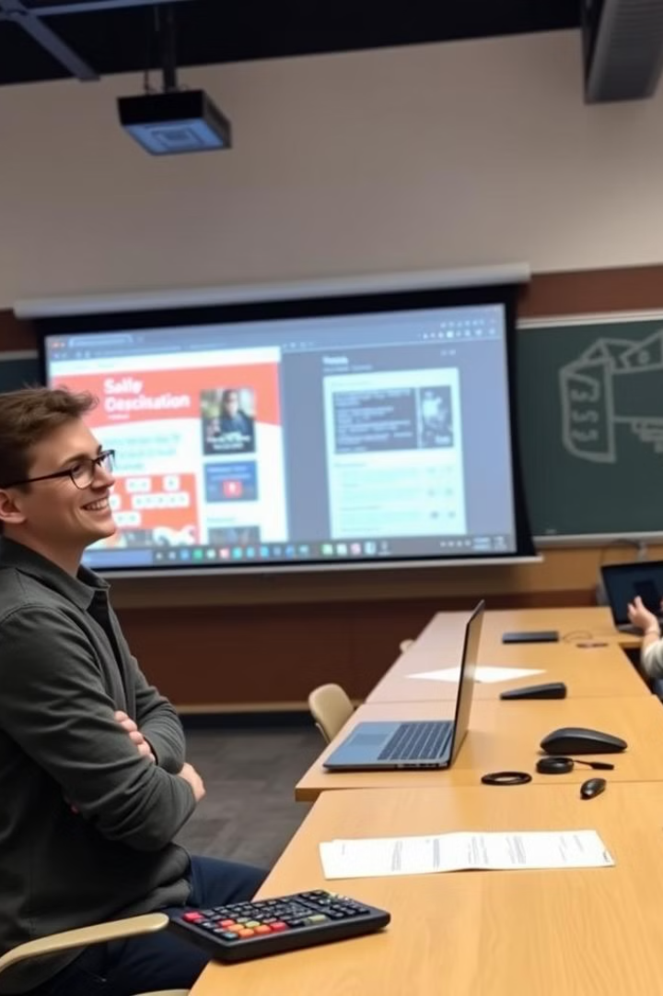



Skills Learned
HTML Basics
Creating structured web content.
JavaScript Fundamentals
Implementing interactive features and logic.
Problem-Solving
Overcoming coding challenges in real projects.

Slide 8
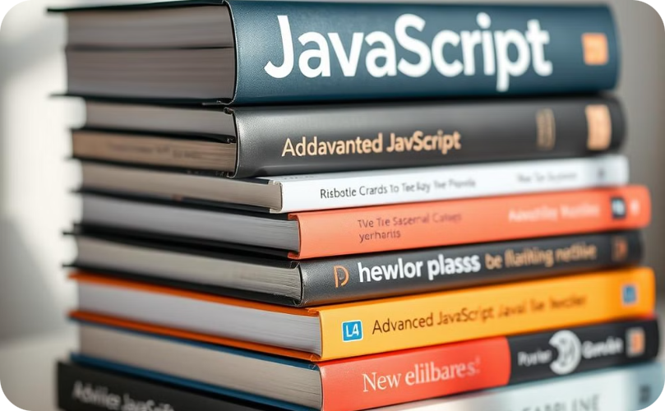
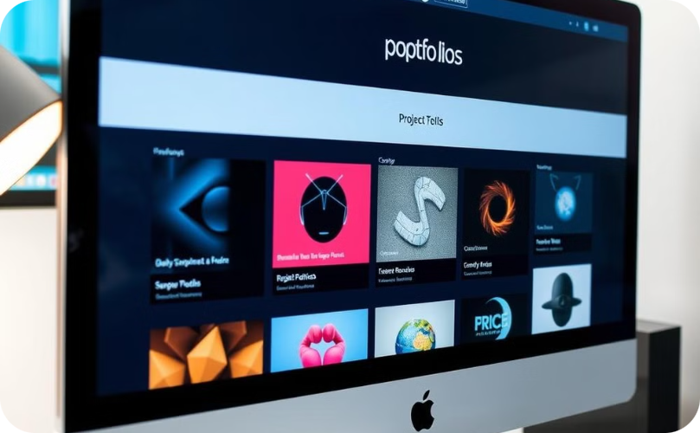
Conclusion and Next Steps
Further Learning
Portfolio Building
Explore advanced web technologies.
Create more diverse web projects.

